Slide 1
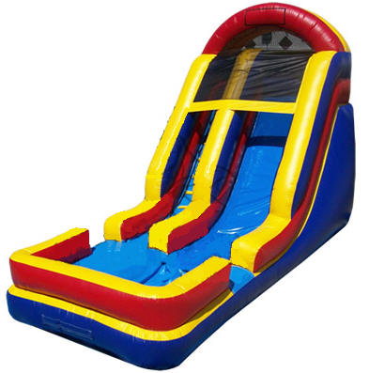
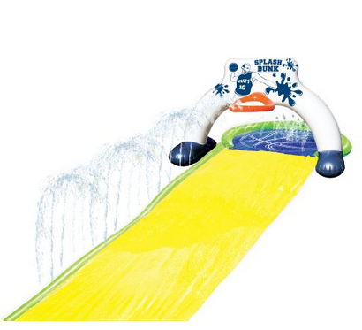
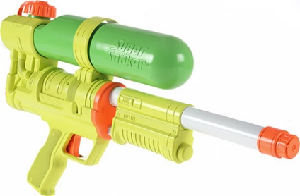
Parents go out! Kids come have fun!!
Ready…
Set….
GET WET!!
July 29 5:30 P.M.–9:30 P.M.
10515 W. Odeum Ln ♦ Tolleson, Arizona
(Cross-streets: 107th Ave. and Lower Buckeye Rd.)
Join us for a great time of FUN!!
$7.50
Non-Adoptees
WATER DAY
$5.00
Adoptees
Sponsored by: Hope Foundation of Arizona
Adoption Support Organization

